Slide 1
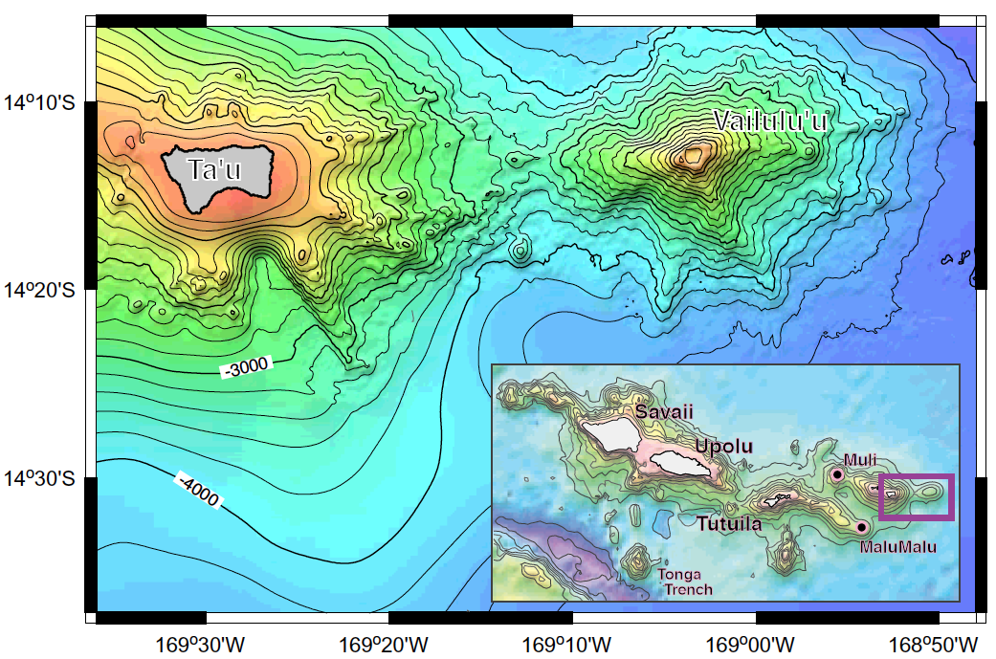
Hart et al (G-cubed, 2001)
Vailulu’u is an active underwater volcano located at the far eastern region of American Samoa.

Slide 2
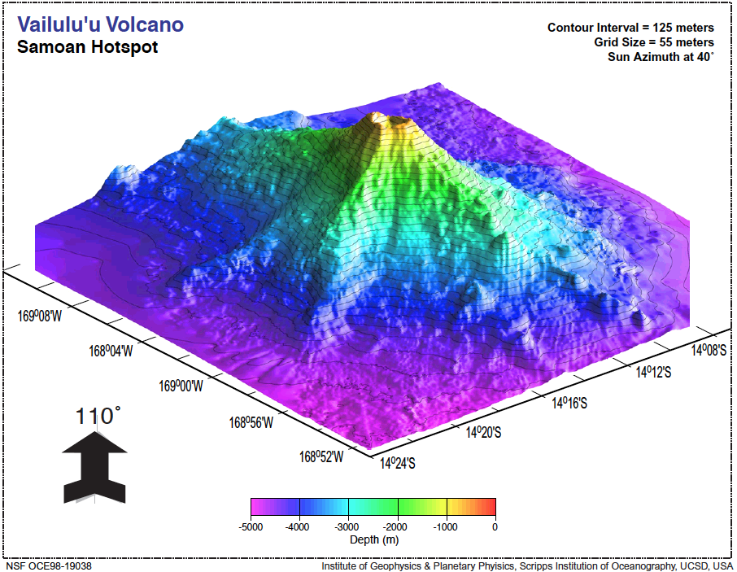
Hart et al (G-cubed, 2001)
Vailulu’u seamount is an active volcano with a clear conical shape. Note the crater at the summit.

Slide 3
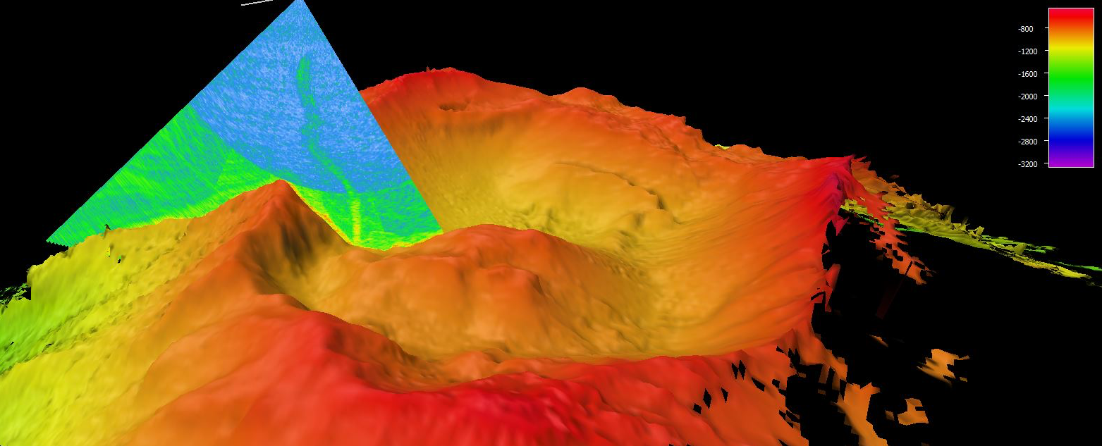
plume
Last week, the Okeanos Explorer mapped the crater of Vailulu’u.
A plume was discovered to be rising from the volcano!
This could be a sign of hot water emanating from the volcano

Slide 4
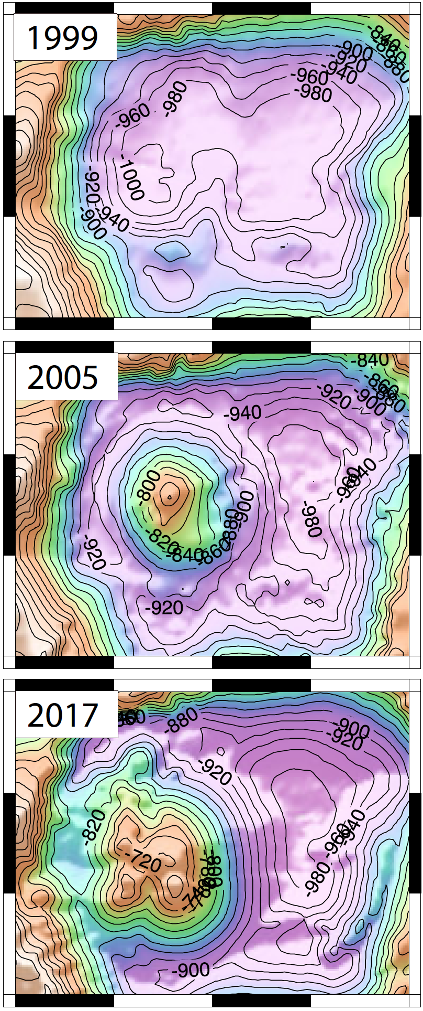
Vailulu’u volcano has been actively erupting lava over the past 18 years.
In 1999, the crater of Vailulu’u was essentially empty.
By 2005, a 1000 foot tall volcanic cone grew in the crater of Vailulu’u.
In 2017, we identified significant growth of the volcanic cone

Slide 5
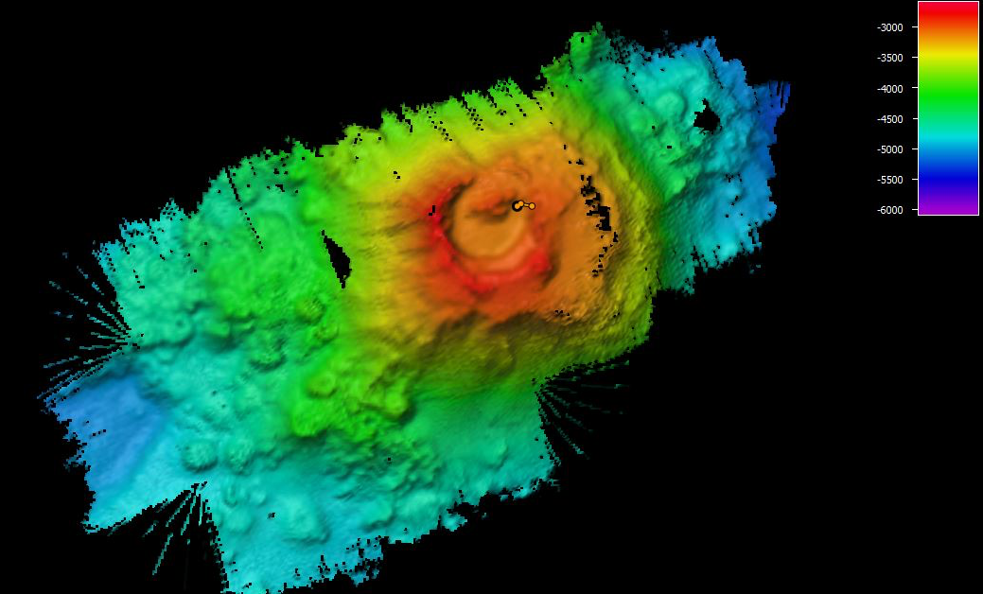
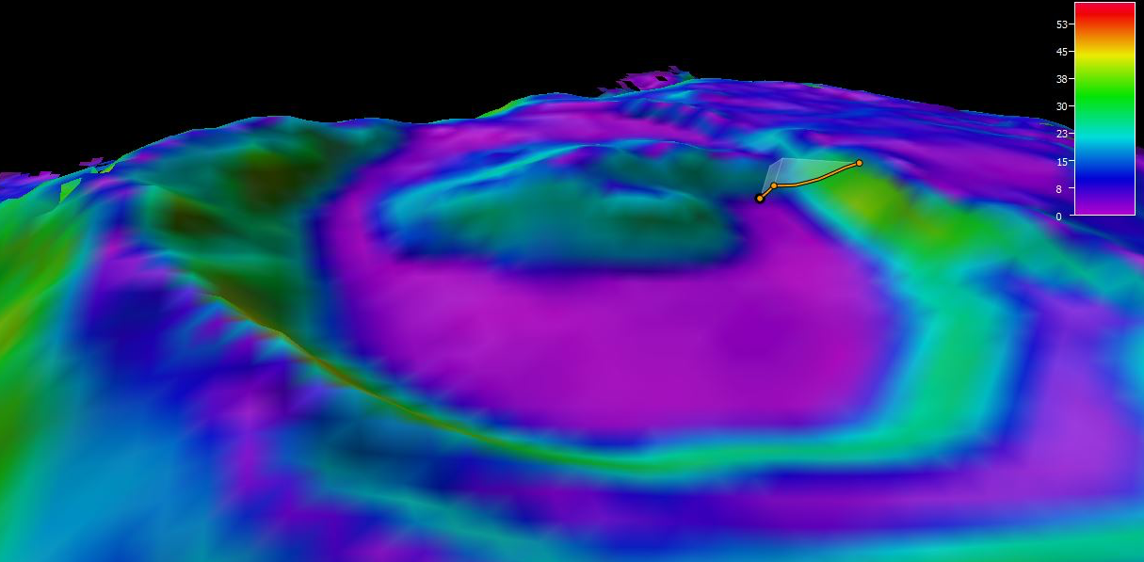
There are other volcanoes in Samoa that were once active. This volcano, located 180 nautical miles northwest of Tutuila. Notice the crater? The cone?

Slide 6
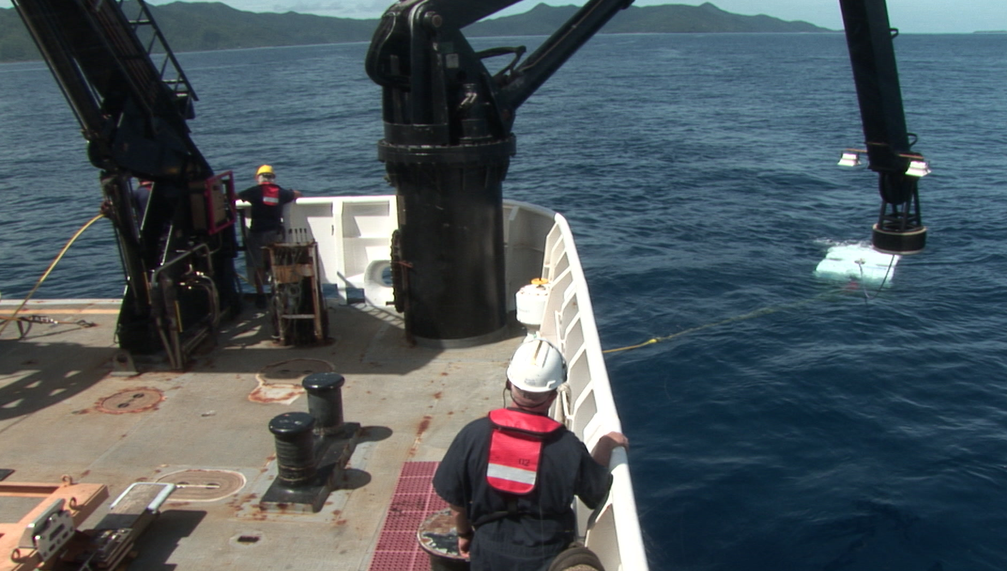
We use an underwater robot, an ROV (remotely operate vehicle), to explore underwater volcanoes.

Slide 7
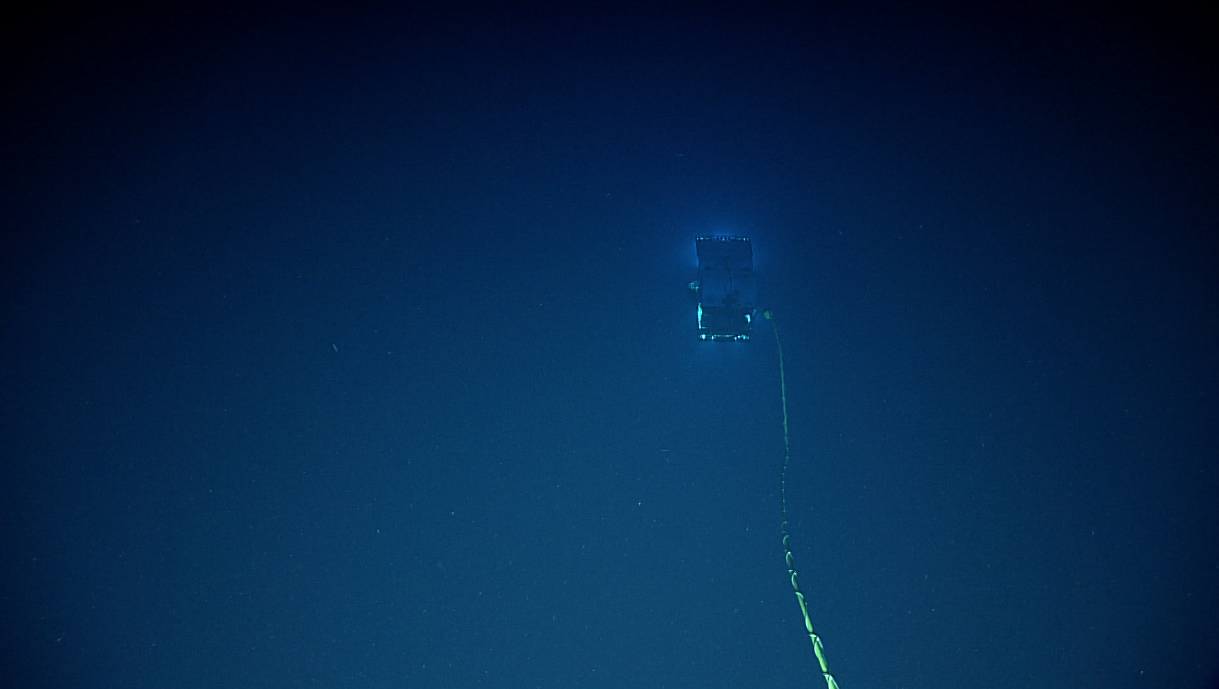
The ROV dives in the deep ocean and has a tether that provides power and communication with the ship.

Slide 8
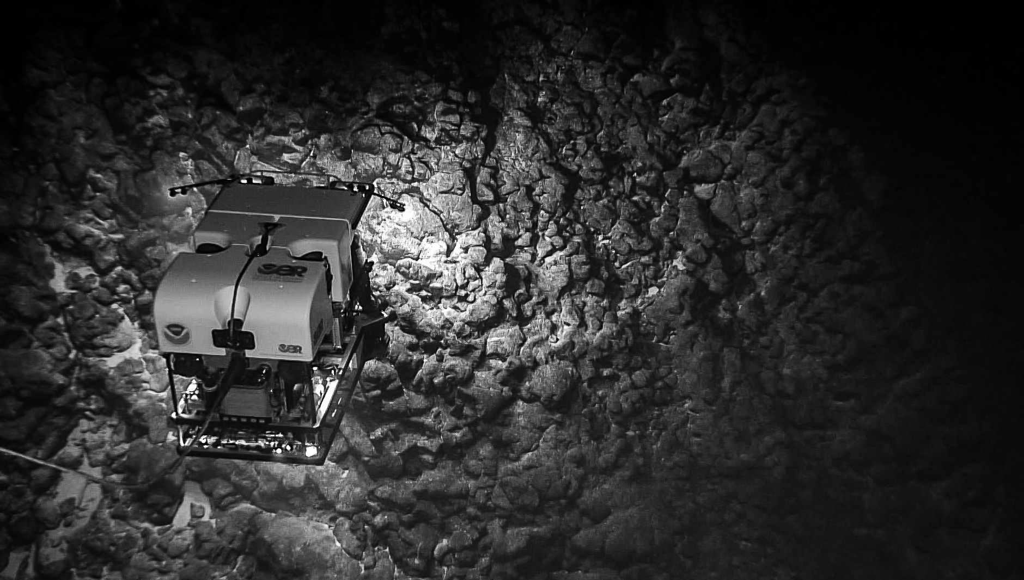
The ROV explores ancient underwater lava flows.

Slide 9
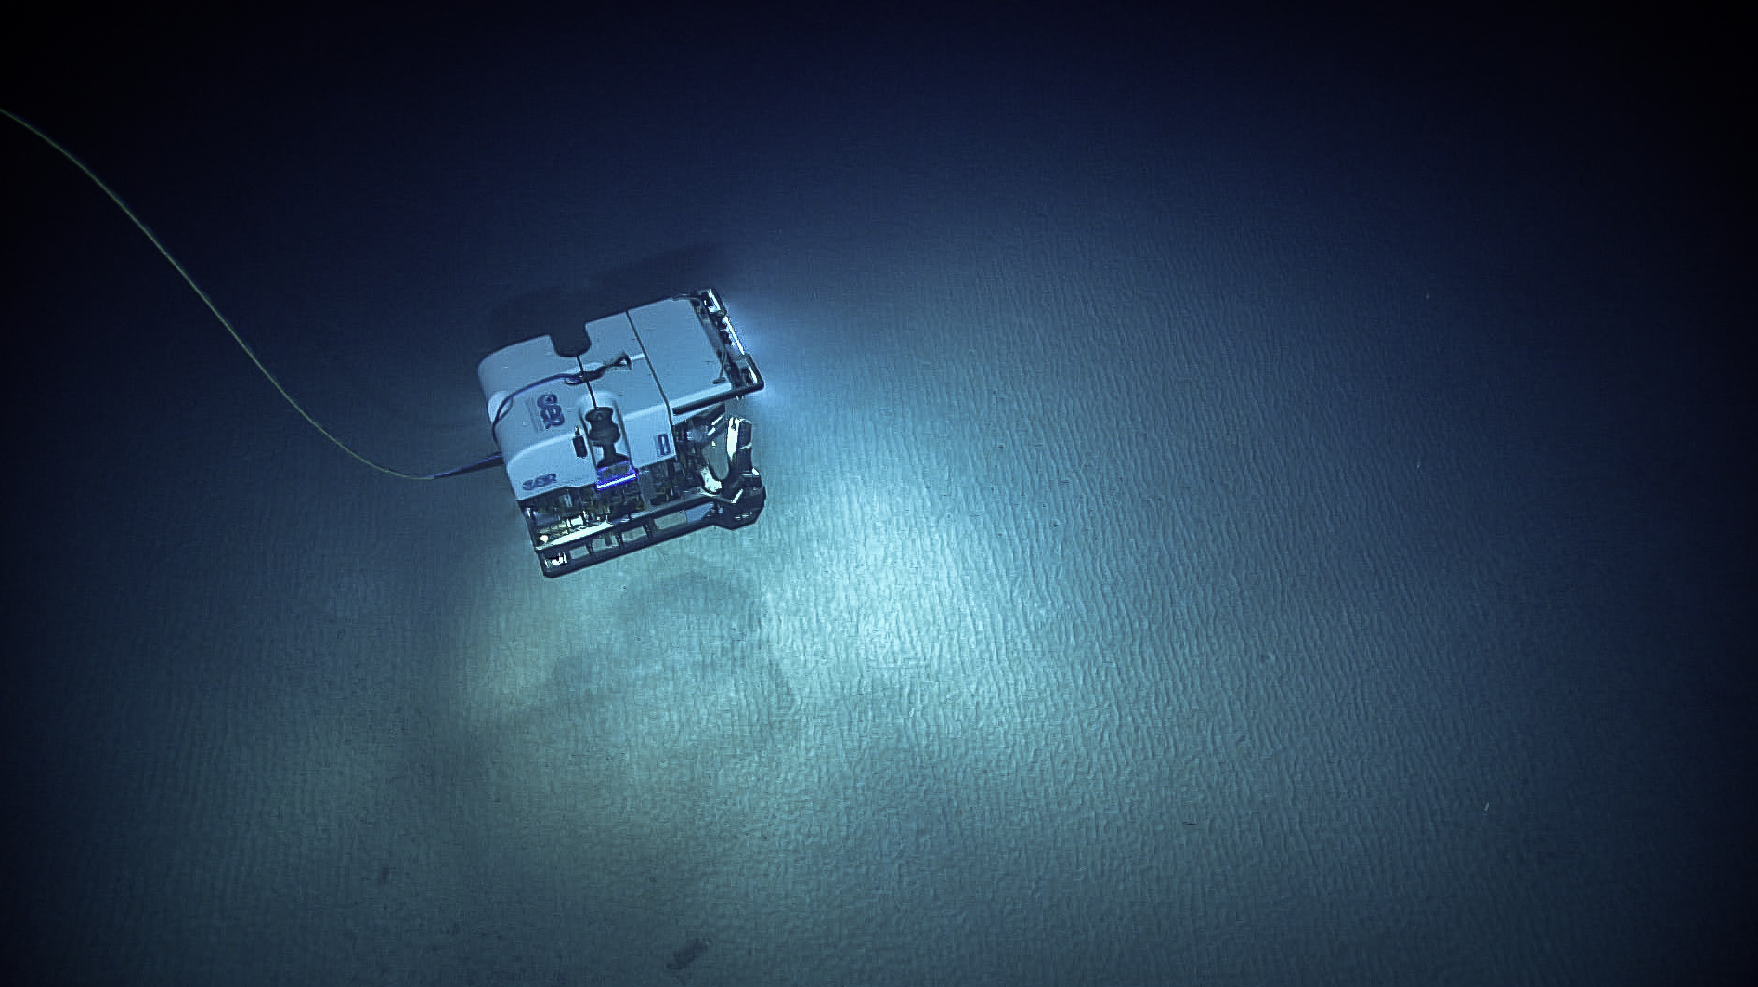
The ROV explores sediment on the ocean floor

Slide 10
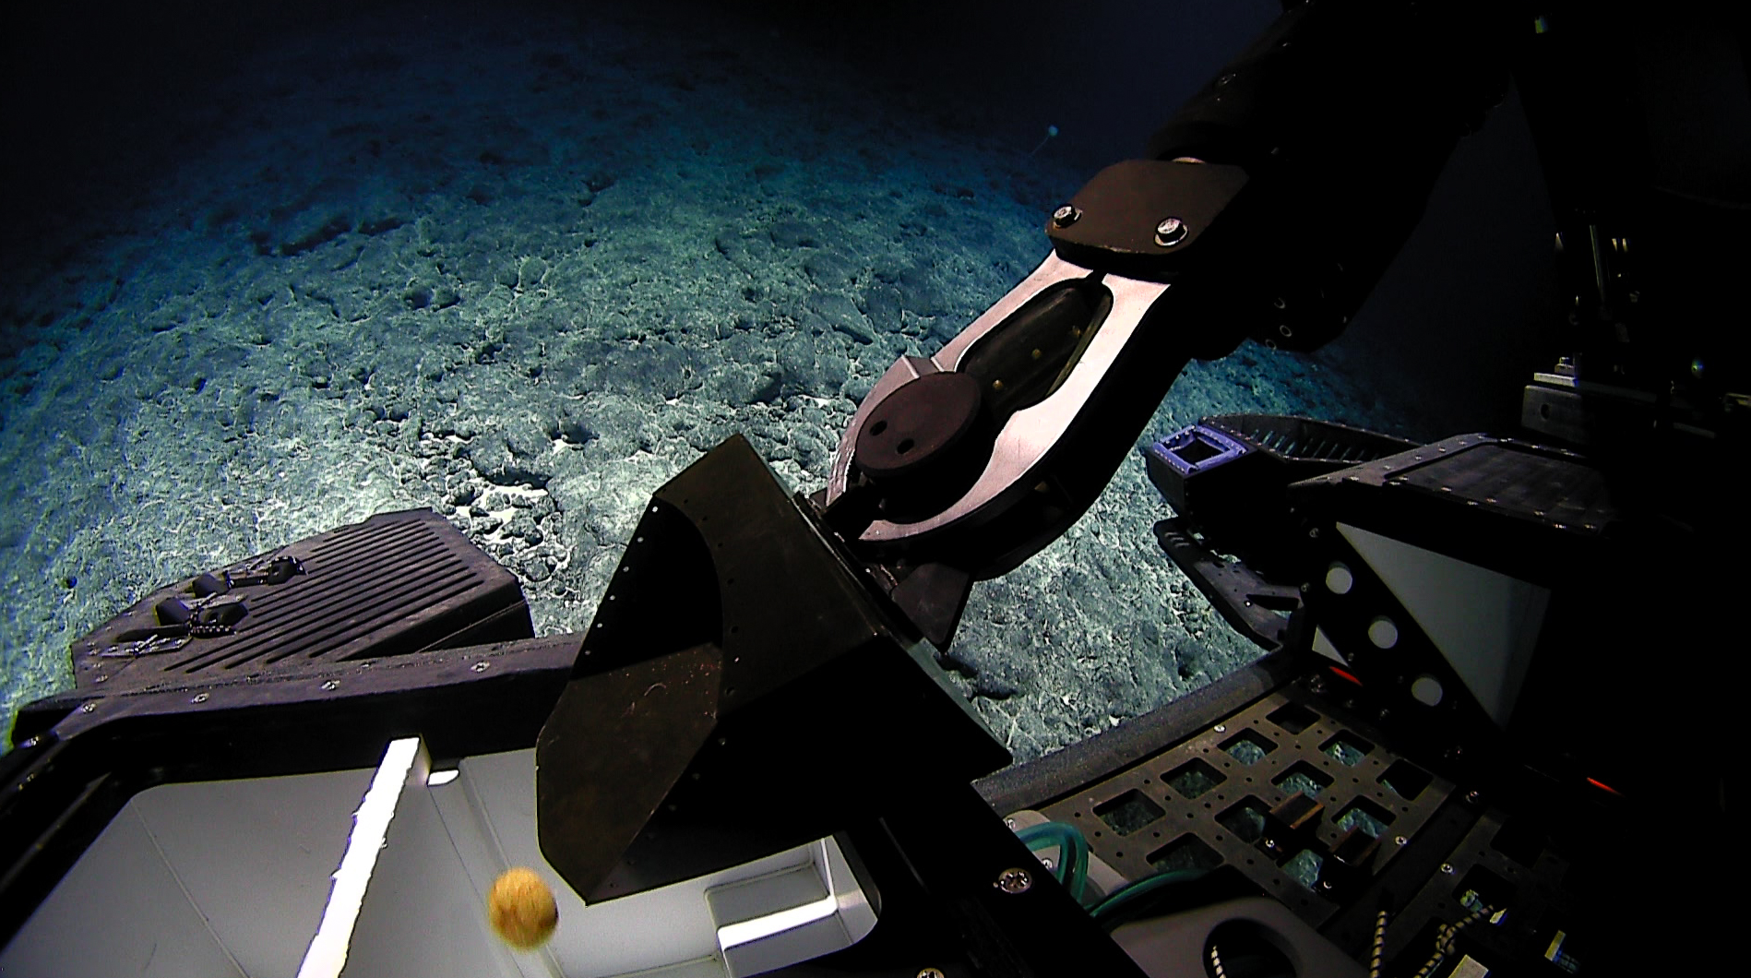
The ROV uses a claw to grab samples that are brought back to the surface for scientists to study.

Slide 11
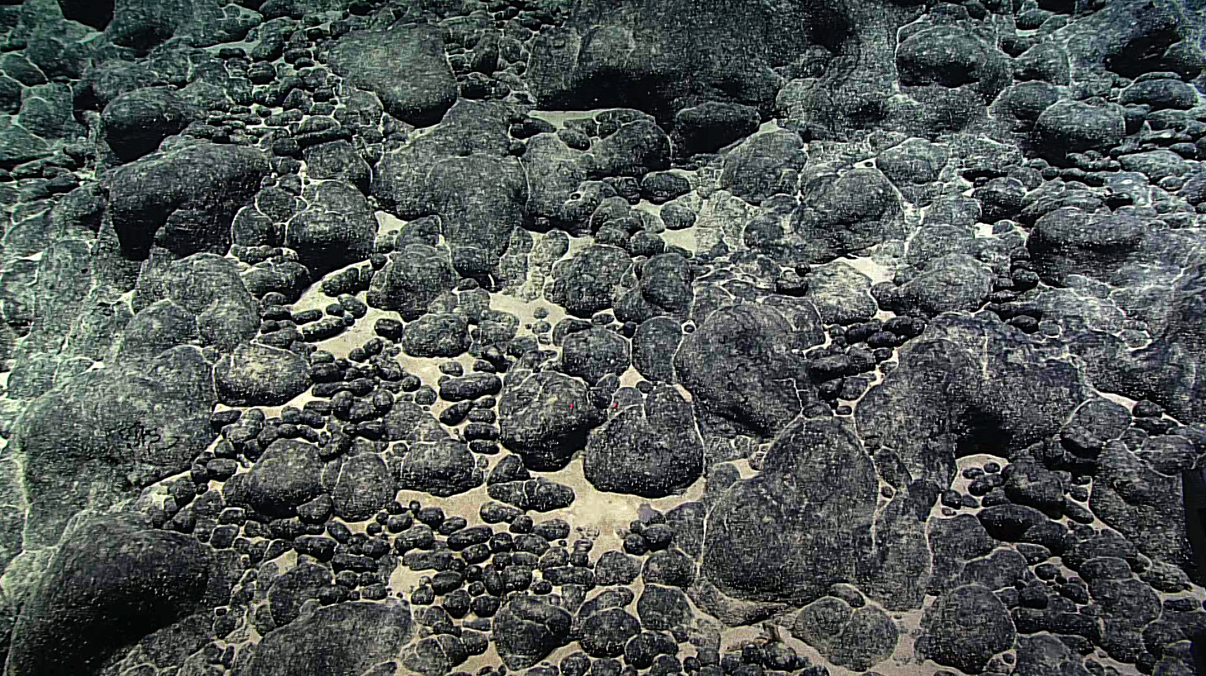
The ROV takes images of submarine geology, including the ferromanganese nodules shown in this figure.

