Slide 1
Potential New Species

Slide 2
Detail of extended polyps of a potential new species of mushroom octocoral (likely genus Anthomastus). Octocorals have the 8 tentacles in each polyp with lateral protections that give them the appearance of tiny feathers.
Notes:
EX1702_IMG_20170218T002135Z_ROVHD.jpg

Slide 3
Cookie star in the genus Astroceramus sitting on bare rock in the deep slopes of Tutuila island. This animal is likely a potential new species discovered in this expedition
Notes:
EX1702_IMG_20170218T030517Z_ROVHD.jpg

Slide 4
Potential new species of dandelion siphonophore, from the family Rhodalidae, using its tentacles to attach to the iron-manganese encrusted rocks in the deep slopes of Rose Atoll.
Notes:
EX1702_IMG_20170218T213855Z_ROVHD.jpg

Slide 5
Potential new species of cookie star from the family Goniasteridae
Notes:
EX1702_IMG_20170221T014854Z_ROVHD.jpg

Slide 6
Ancient, Manganese-Encrusted Sponges

Slide 7
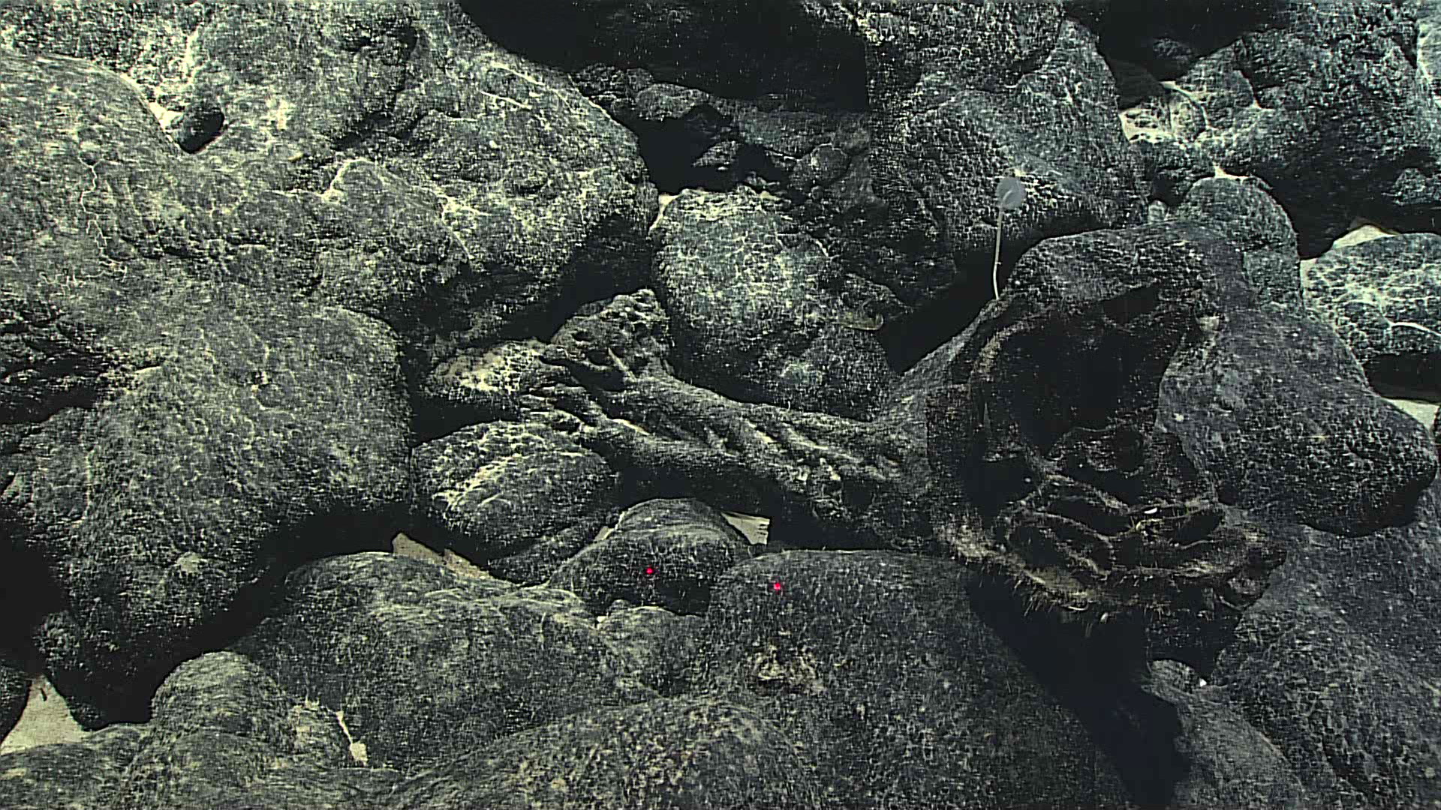
Hidden amongst the rock on the deep slopes of Rose Atoll are ancient sponge fossils encrusted with manganese. The manganese crust has taken hundreds of thousands to millions of years to form as the ferromanganese deposits precipitate from seawater, and cover the sponge skeleton!
Notes:
EX1702_IMG_20170218T215436Z_ROVHD.jpg

Slide 8
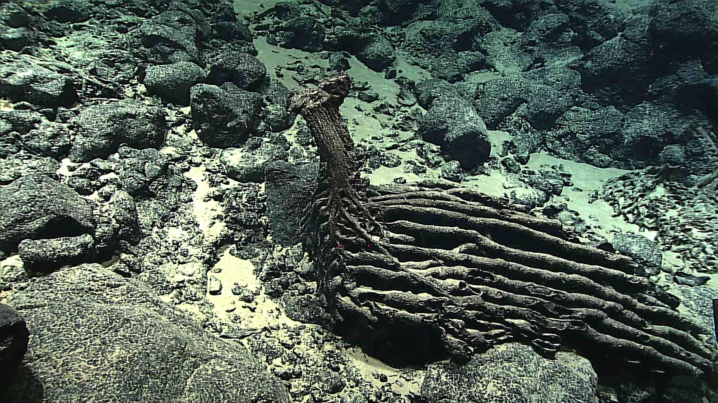
The deep slopes of Rose Atoll contain ancient sponge fossils encrusted with manganese. The manganese crust has taken hundreds of thousands to millions of years to form as the ferromanganese deposits precipitate from seawater, and cover the sponge skeleton!
Notes:
EX1702_IMG_20170219T001925Z_ROVHD.jpg

Slide 9
Ancient Coral Bases

Slide 10
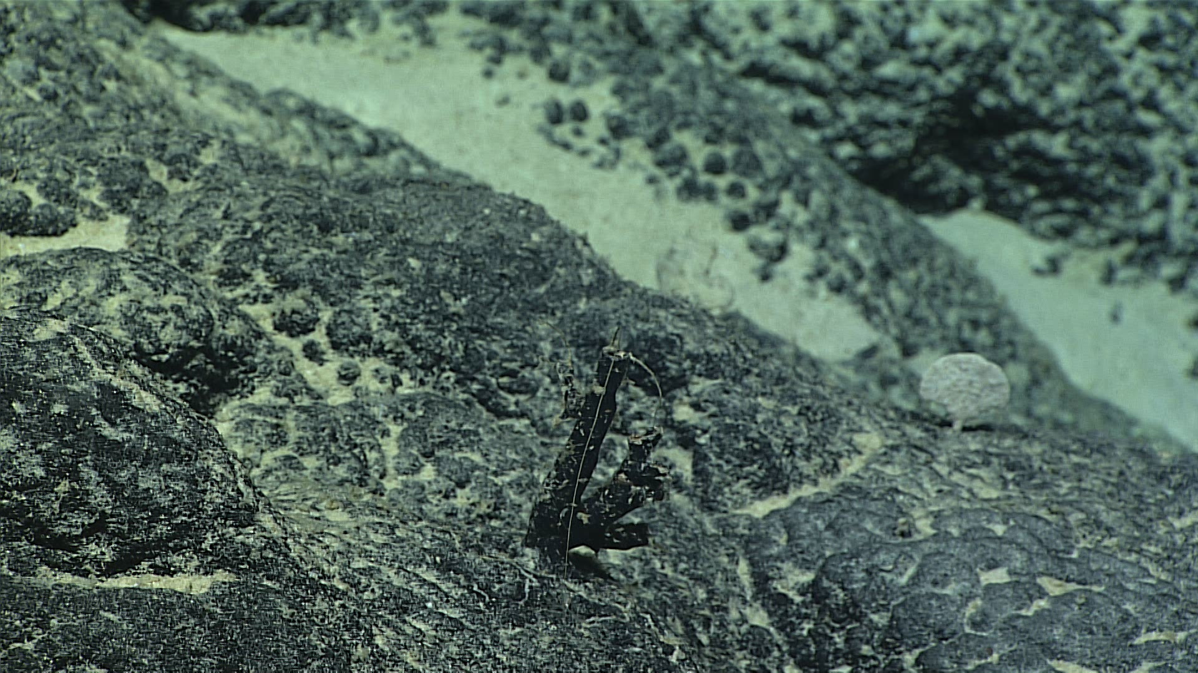
Near the summit of Moki seamount, the remnants of ancient coral skeletons are encrusted with manganese. The manganese crust has taken hundreds of thousands to millions of years to form as the ferromanganese deposits precipitate from seawater, and cover the coral skeleton! These fossils give us insight into the past and present coral communities on this seamount.
Notes:
EX1702_IMG_20170222T220544Z_ROVHD.jpg

Slide 11
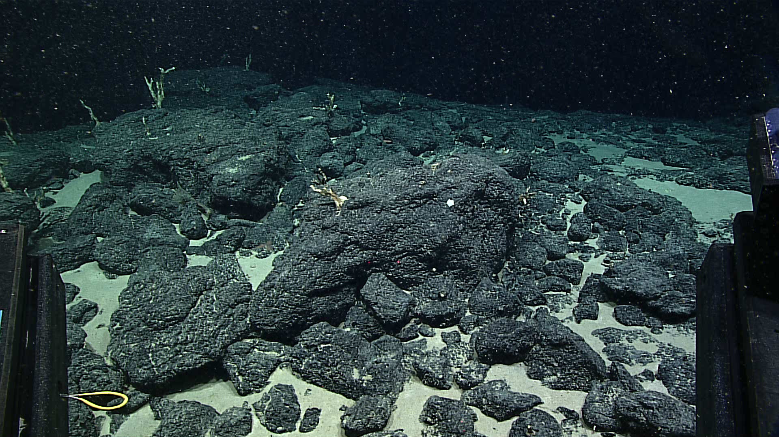
More recent remnants of corals near the summit of “Moki” seamount are younger and less encrusted, providing another window to the biological communities changing over time on this seamount.
Notes:
EX1702_IMG_20170223T001553Z_ROVHD.jpg

Slide 12
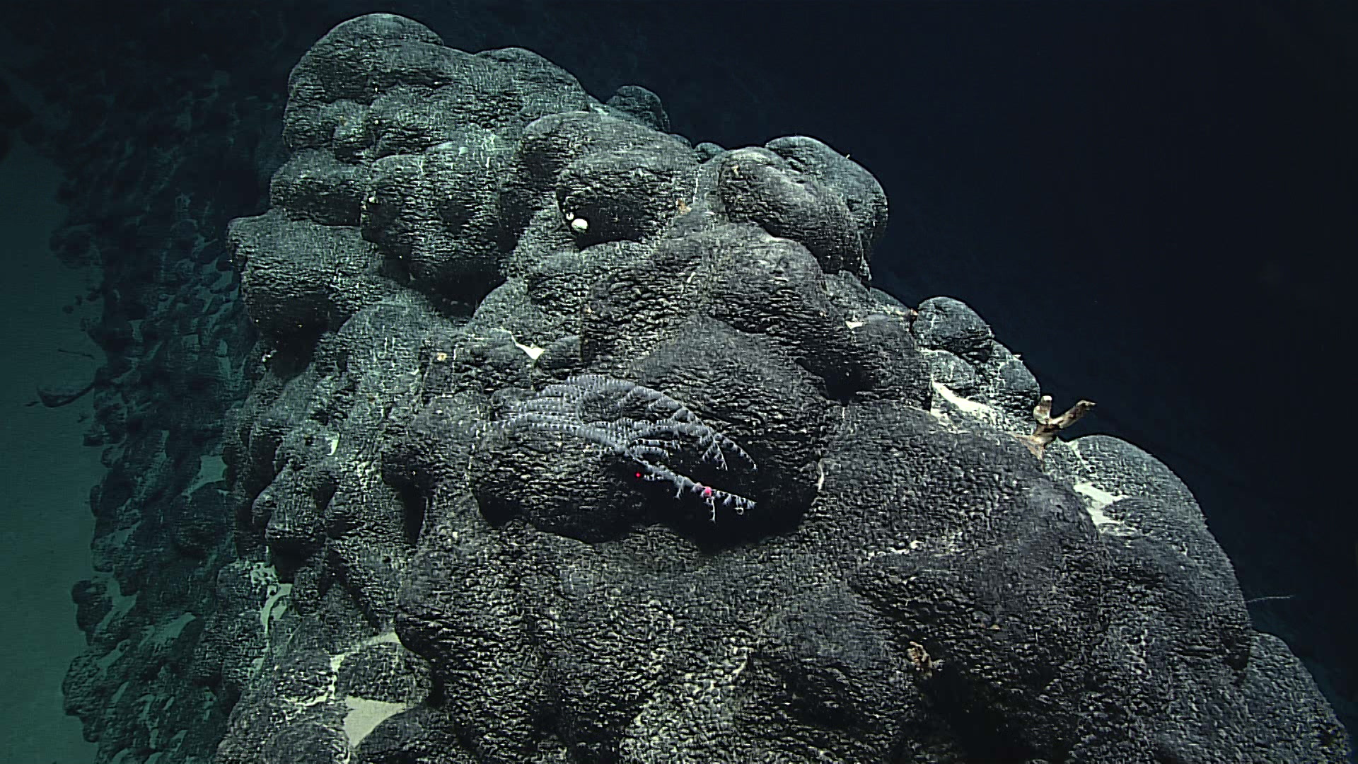
A view of past and present coral communities near the summit of “Moki” seamount: on the center, a living golden coral is attached to a rocky outcrop. To its right is a dead skeleton of a different species of coral partially encrusted with ferromanganese crust. The rocky outcrop is coated with ferromanganese crust.
Notes:
EX1702_IMG_20170222T221820Z_ROVHD.jpg

Slide 13
Other Cool Animals

Slide 14
Seastar feeding on the polyps of a bamboo octocoral. The white branches with black bands reveal the feeding path of the seastar.
Notes:
EX1702_IMG_20170218T234123Z_ROVHD.jpg

Slide 15
Unusual association between a ‘spiny’ brittle star and a golden octocoral from the family chrysogorgiidae . The brittle star may have eaten or scraped some of the coral’s living tissue.
Notes:
EX1702_IMG_20170222T005929Z_ROVHD.jpg

Slide 16
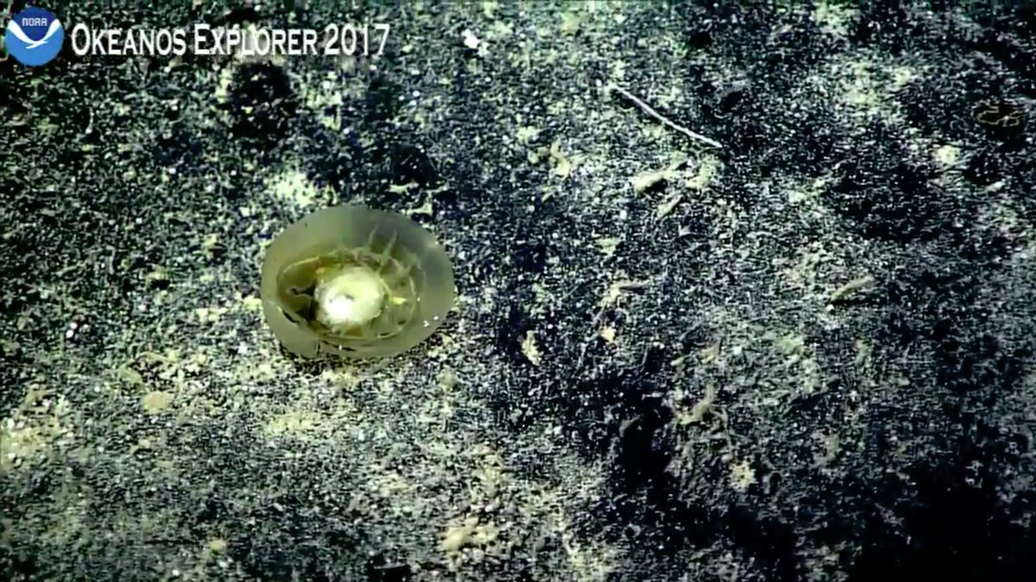
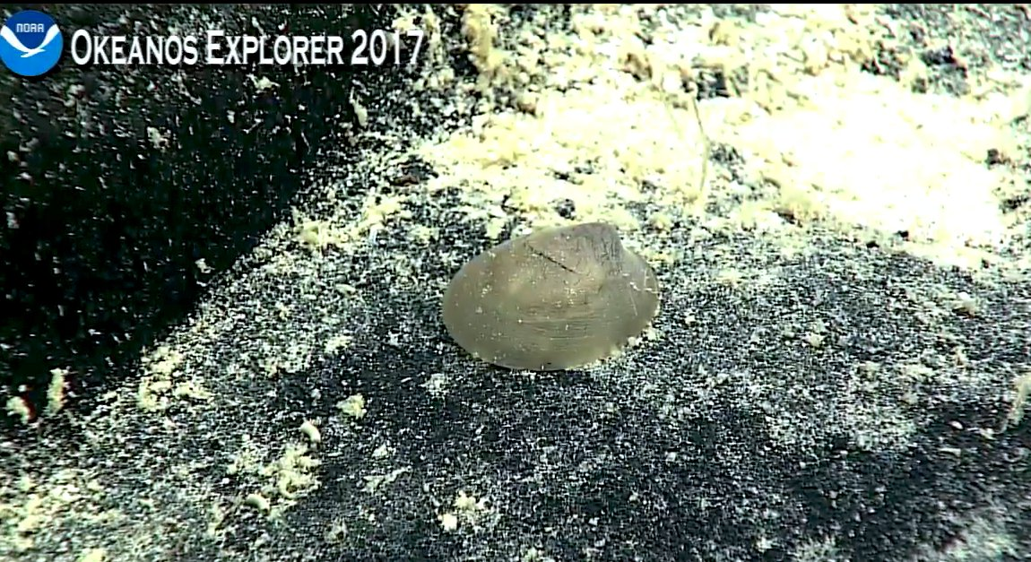
A Monoplacophoran - very rare deep-sea mollusk is observed ALIVE on the seafloor for likely the first time! This animal is considered a living fossil.
Notes:
Monoplacophoran and TRAIL! #ichnos About 3800 m #Okeanos Utu seamount

